Slide 1
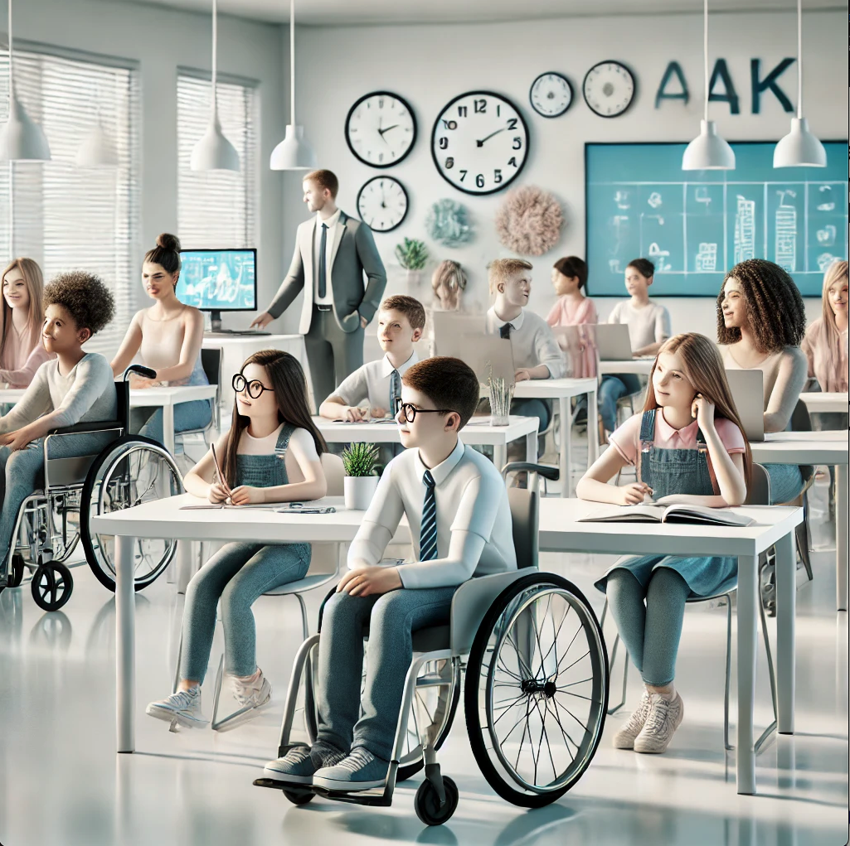

Capstone Project - Adaptive Student Arrangement System for Enhanced Learning
24-2-D-1
By the students:
Nabi Mari- 316197490
Yoda Amer- 211853502
By the mentor:
Dr. Natali Levi
Notes:
the project was carried out under the supervision of our mentor, Natali,

Slide 2

AGENDA
INTRODUCTION
PROBLEM
CURRENT TECHNOLOGIES
OUR PRODUCT
TECHNOLOGY STACK
MOTIVE AND EVALUATION

Slide 3

INTRO – Classroom Seating
Classroom seating is a fundamental aspect of the learning environment that significantly influences students' academic success and social interactions. Research has shown that the way seats are arranged can affect students' ability to focus, their participation, and how they interact with peers and teachers. Proper seating arrangements help minimize distractions, promote collaboration, and support diverse learning needs, making seating an essential consideration for teachers when managing classroom dynamics.
* Gremmen, M. C., van den Berg, Y. H. M., Segers, E., & Cillessen, A. H. N. (2016). Considerations for classroom seating arrangements and the role of teacher characteristics and beliefs. Social Psychology of Education: An International Journal, 19(4), 749–774.
Notes:
Intro- Seating arrangement was and still a huge problem for both the teachers and students,
-once a student gets the wrong seat ,it will affect his performance and social interaction with the teacher and other classmates

Slide 4

Problem
Traditional classroom seating is often fixed and doesn’t easily adapt.
Rows or groups of desks don’t account for how each student learns or behaves.
These seating arrangements can make students less engaged and may lead to more behavior problems.
Students with special needs might not get the help they need in these setups.
Fixed seating can make it hard for students to interact, which might make some feel left out.
Notes:
the problem is caused due to the fact that once there is a random seating arrangement it cant be changed,
So that will affect students from all backgrounds especially students with special needs
his project was carried out under the supervision of my mentor, Natali,

Slide 5
Student Challenges in the Classroom
Hearing Impairments: Difficulty hearing instructions, discussions, or classroom activities, leading to challenges in following along.
Vision Impairments: Difficulty seeing the board, reading materials, or recognizing peers, impacting learning and social interactions.
Emotional and Behavioral Disorders: Struggles with mood regulation, anxiety, depression, or anger management.
Speech and Language Disorders: Difficulty expressing oneself or understanding spoken language, leading to communication barriers.
Physical Disabilities: Mobility challenges or other physical impairments that require special seating arrangements or assistive devices.
Notes:
Challenges- some of the challenges a student can have is :
-Vision impairment and hearing impairment so they should be if the first or second row
-emotional and behavioral disorder maybe setting close to the teacher will help

Slide 6
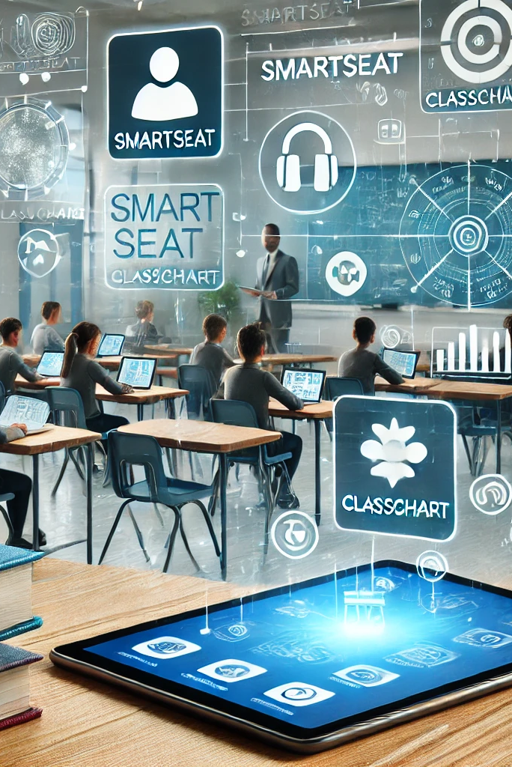
CURRENT TECHNOLOGIES
SmartSeat:
Allows teachers to create and adjust digital seating charts based on student data.
Helps manage classroom dynamics by visually organizing students according to their needs.
ClassChart:
Provides tools for behavior tracking and seating arrangements.
Integrates student data to optimize classroom layouts and monitor progress.
ClassDojo:
Engages students through behavior management and rewards systems.
Connects teachers, students, and parents with real-time feedback and communication.
Notes:
Introduction:
"In today’s classrooms, technology plays an important role in enhancing teaching and learning. Let's take a look at some of the key tools being used."
SmartSeat:
"SmartSeat allows teachers to create and adjust digital seating charts based on student data, helping manage classroom dynamics more effectively."
ClassChart:
"ClassChart provides tools for behavior tracking and seating arrangements, integrating student data to optimize classroom layouts."
ClassDojo:
"ClassDojo focuses on behavior management and engagement, connecting teachers, students, and parents with real-time feedback."
Conclusion:
"These supporting data decisions and improving the learning environment."

Slide 7

Limitations of Current Classroom Management systems
ClassCharts:
Manual Updates: Teachers must manually adjust seating arrangements; lacks automatic real-time adjustments.
Time-Consuming: Updates can be time-consuming and may not reflect current student interactions.
Notes:
"While ClassCharts is a valuable tool, it does have some limitations that can impact its effectiveness in the classroom.“
"ClassCharts needs teachers to manually adjust seating, as it doesn't update automatically with real-time data. This can take a lot of time and may result in less accurate seating arrangements."

Slide 8

Limitations of Current Classroom Management systems
SmartSeat:
No Real-Time Data Integration: Does not automatically adjust seating based on ongoing data or student behavior.
Manual Effort Required: Teachers need to manually update seating and observations, which can be labor-intensive.
Notes:
"Now, let's look at some limitations of the SmartSeat system, which is widely used in classrooms."
SmartSeat requires teachers to manually update seating and observations,
as it doesn't automatically adjust based on real-time data or changes in student behavior, making the process time-consuming

Slide 9

Limitations of Current Classroom Management systems
ClassDojo:
Data Privacy Concerns: Tracks and shares personal information, raising issues about data security.
Third-Party Sharing: Information is shared with third parties, which could lead to potential data breaches.
Notes:
let's discuss some concerns with ClassDojo, a popular tool for classroom management.“
"ClassDojo tracks and shares personal information, which raises privacy concerns, especially since the data is sometimes shared with other groups, increasing the risk of data breaches."

Slide 10
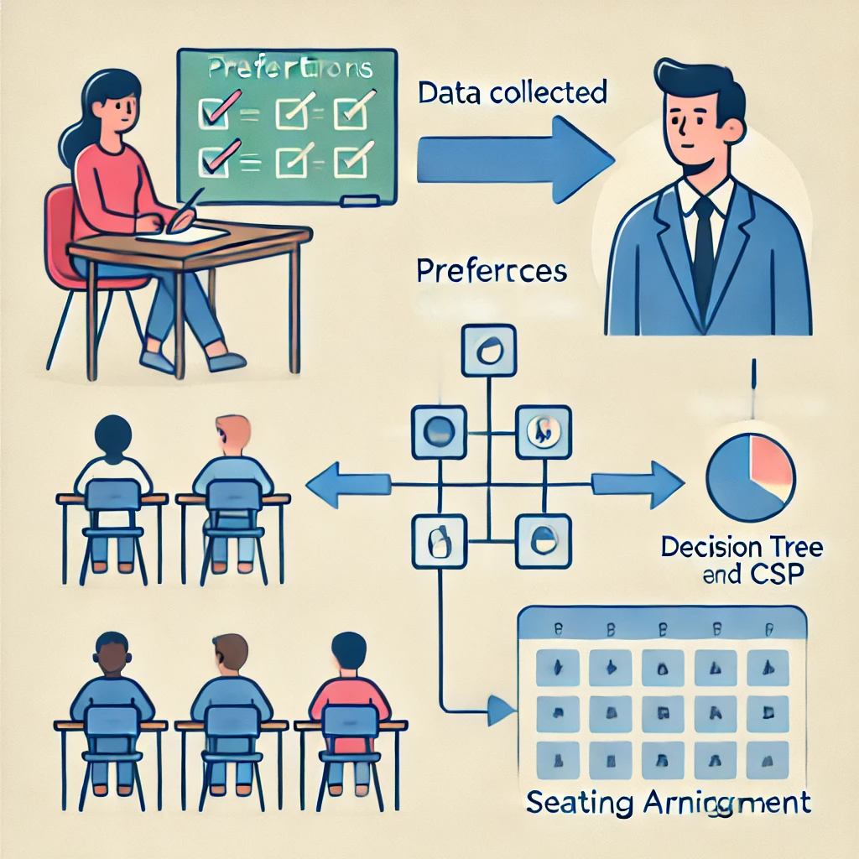
Our Product
Our project aims to create an efficient virtual classroom seating arrangement system that fosters an inclusive and supportive learning environment. By considering factors such as students' backgrounds, behaviors, special needs, language skills, and social dynamics.
Notes:
aims to create an efficient virtual classroom seating arrangement system
By considering the factors of each student to make sure each student set in the best seat

Slide 11
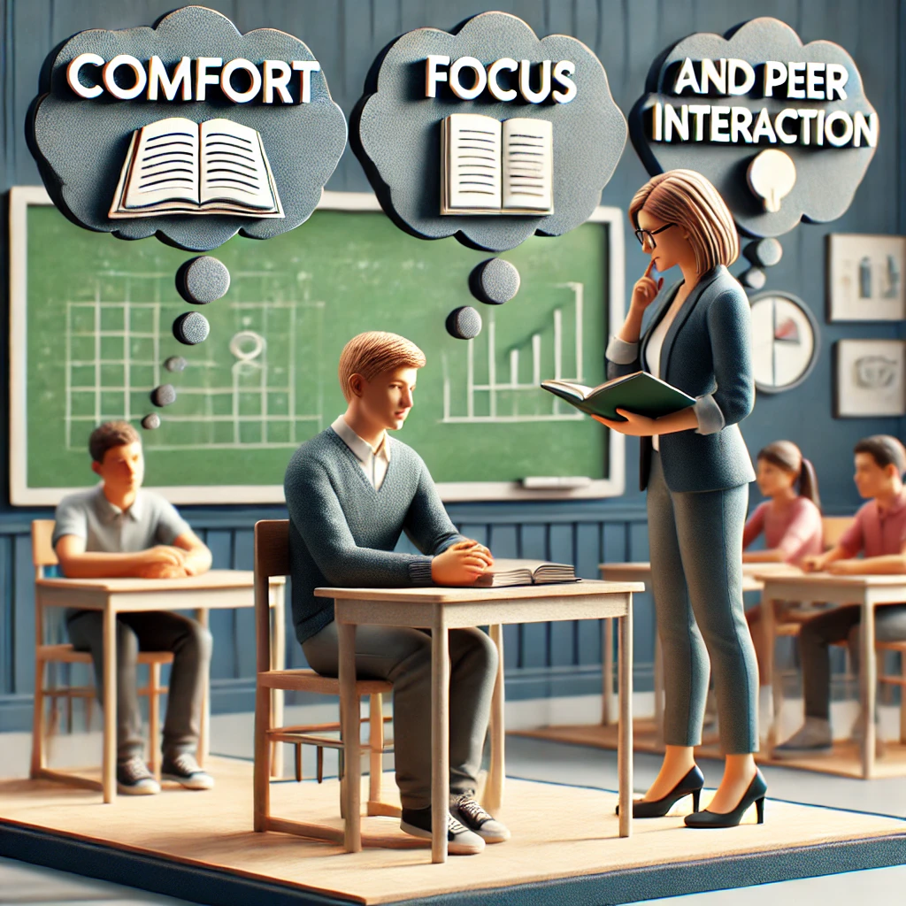
Student Seating Preferences Questionnaire
Comfort and Focus:
Where do you like to sit in the classroom?
Do you find it easier to focus when you sit in a specific part of the room? If yes, where?
Peer Interaction:
Do you prefer sitting next to your friends, or do you focus better when sitting with other classmates?
When we do group activities, do you like to be with your friends, or do you prefer being in a group with different students?
Notes:
Questionnaire- how the teacher knows whats every students problems?
The teacher does a questionnaire for every student to know everything about his background and also if he have special needs
Comfort and Focus:
(For example: front, middle, back, near windows, near the door)

Slide 12
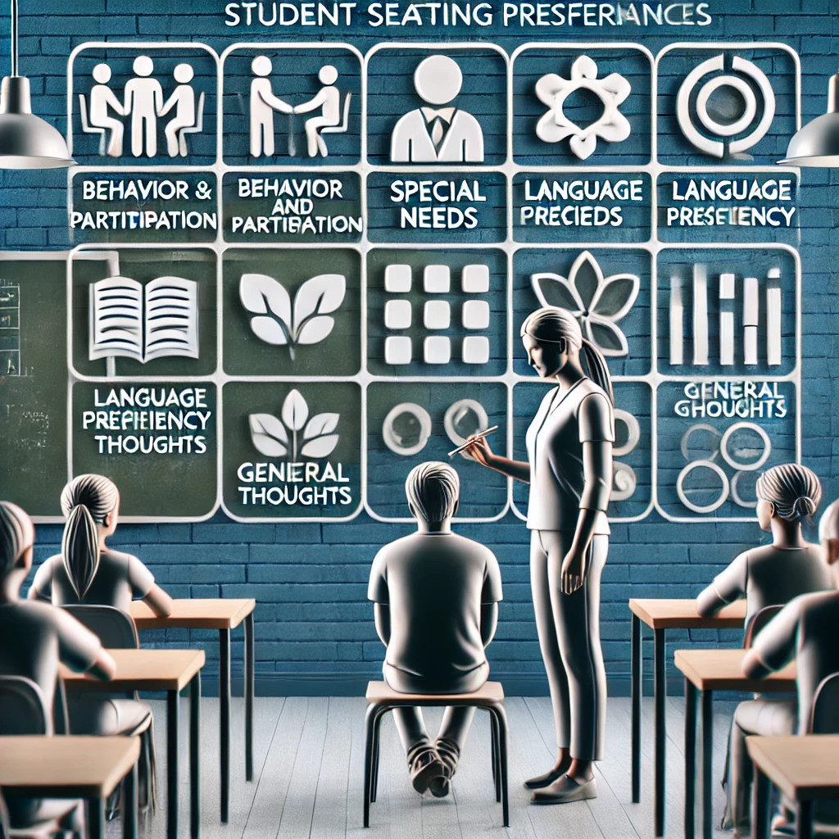
Student Seating Preferences Questionnaire
Behavior and Participation:
Are there certain spots in the classroom where it’s harder for you to stay on task?
Special Needs:
Is there anything special you need in your seating arrangement to help you feel comfortable and do your best in class?
Language Proficiency:
Do you speak a language other than English at home?
General Thoughts:
Is there anything else you want to tell me about where you sit in class?
Notes:
After we take all this data,
The data put into a decision tree to get optimized and then sent into csp algorithm using ac-3 to create the best seating arrangement
Special Needs:
(For example: sitting close to the teacher, needing a special chair)
2. All this data goes to a decision tree to get the optimized data on each student
3.We pass this data to csp alg with ac-3 function to make sure each node is sataisfied

Slide 13
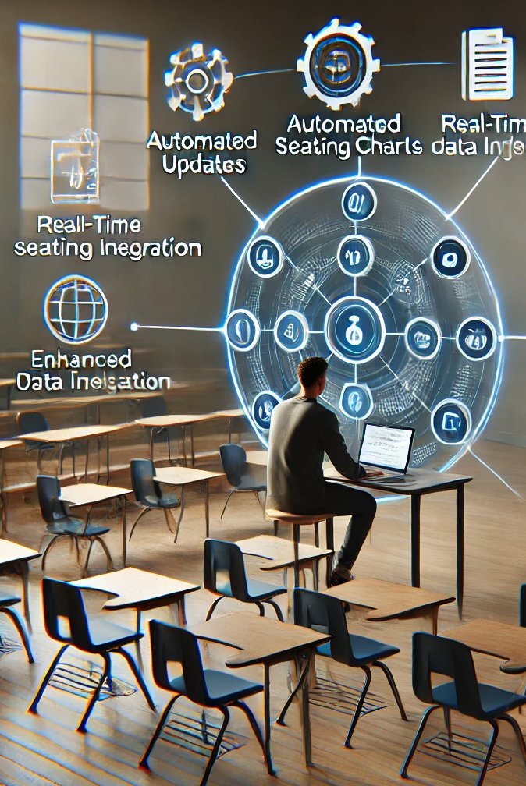
System Advantages
Automated Updates: Our system automatically updates student information in real-time, reducing the need for manual data entry and saving time for teachers.
Real-Time Data Integration: Unlike existing tools, our system integrates real-time data on student behavior, performance.
Minimal Manual Effort: With advanced algorithms like Decision Trees and CSP, the seating arrangement is personalized and optimized without requiring time-consuming manual setup.
Enhanced Data Privacy: Our system ensures strict data privacy controls, with no third-party sharing, providing better security for sensitive student information.
Notes:
Automated Updates: Our system automatically updates student data in real-time, reducing the manual workload for teachers.
Real-Time Data Integration: It uses real-time student data to make dynamic seating adjustments based on behavior and preferences.
Minimal Manual Effort: Advanced algorithms like Decision Trees and CSP personalize and optimize seating .
Enhanced Data Privacy: The system ensures student data is secure, with no sharing of sensitive information with third parties.

Slide 14




Technology Stack
HTML5
MongoDB
JavaScript
Vercel
Notes:
"Our project uses HTML5 for the structure, MongoDB for database management, JavaScript for dynamic functionality, and Vercel for easy and scalable deployment."

Slide 15
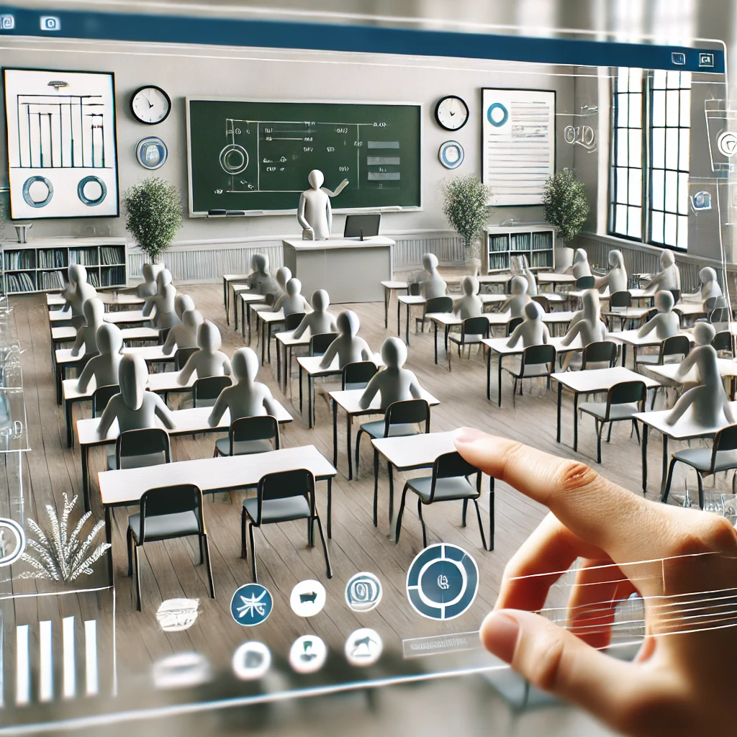
Virtual Class Web App
For our Web App we decided to go with a standard Client-Server architecture.
For the frontend we will use HTML5/CSS3, JavaScript to build the pages dynamically and to style them.
For the backend we will use Node.js to handle requests and to run the server-side, we then deployed said server onto Vercel.
Notes:
"Here, I’ll explain the structure and technologies we are going to use for our Virtual Class Web App.“
Client-Server Architecture:
"We chose a standard Client-Server architecture, which ensures that our app is both scalable and efficient.“
Frontend:
"For the frontend, we’re using HTML5, CSS3, and JavaScript. These technologies allow us to build dynamic and responsive pages that are easy to style and interact with.“
Backend:
"On the backend, we’re using Node.js to handle requests and manage the server-side operations. The server is deployed on Vercel, which provides fast and reliable hosting."

Slide 16
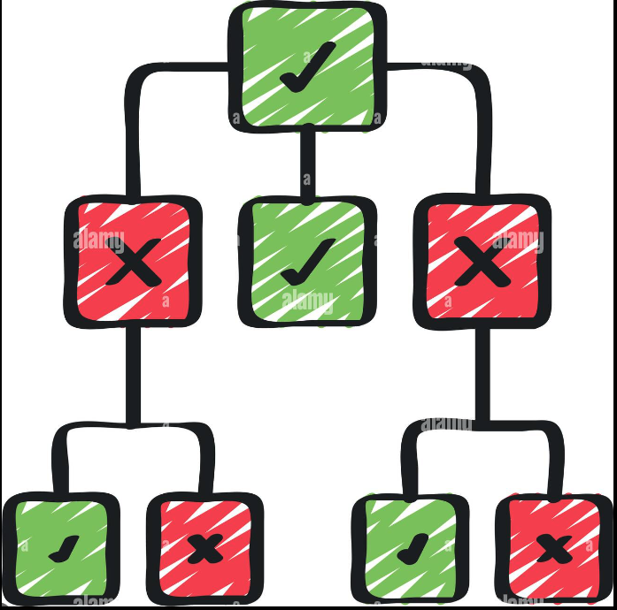

Data Availability
Our system will gather student data provided by their teachers, including insights on educational background, behavior, and special needs. This data is crucial for making the best seating decisions for each classroom.
We will construct a structured dataset by combining these factors, enabling our Decision Tree and CSP algorithms to create seating arrangements that cater to individual student needs.
Notes:
"Our system will gather student data provided by their teachers, including insights on educational background, behavior, and special needs. This data is crucial for making the best seating arrangement for each classroom."
"Once the data is collected, we’ll combine it into a structured dataset. This dataset is then fed into our Decision Tree and CSP (Constraint Satisfaction Problem) algorithm.
The Decision Tree first helps identify key features—such as behavior or learning needs
"After that, the CSP algorithm takes these features and applies various constraints, like keeping students with similar needs together or separating those with conflicting behavior patterns.
The algorithm tests different seating configurations to find the one that best meets the needs of all students."

Slide 17
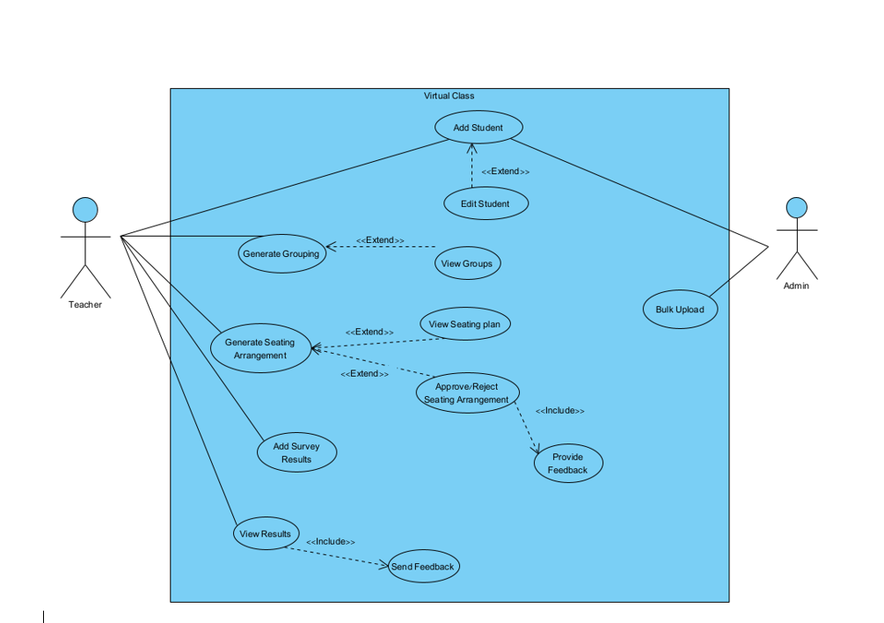
UseCase Diagram
Notes:
In this usecase diagram we have two main Actors, teacher and Admin. The teacher manages tasks like add student Generate Grouping, Generate seating arrangement,
Add survey results and view results.
The admin handles student records including Adding, editing, and uploading multiple data information at once
Bulk upload: Uploading multiple student information in the same time rather than adding them individually

Slide 18
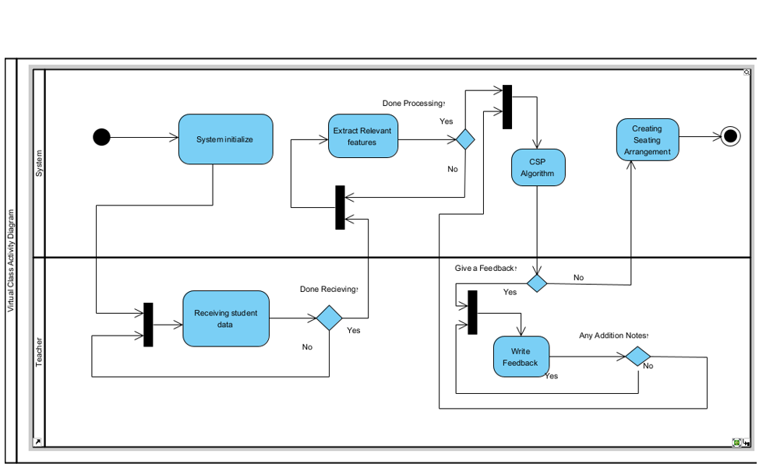
Activity Diagram
Notes:
"The system starts by initializing and then proceeds to extract relevant features from the data provided.
Once the processing is complete, it runs the CSP algorithm to generate the seating arrangement.“
"The teacher’s role involves providing the student data, and after the system generates the seating arrangement,
the teacher has the option to give feedback. If feedback is provided, it can be used to make further adjustments."

Slide 19

Motive And Evaluation
Motive:
Optimize Learning: Improve focus, collaboration, and inclusivity through tailored seating arrangements.
Data-Driven Decisions: Use algorithms like Decision Trees and CSP to personalize seating.
Support Diversity: Address the unique needs of each student for an inclusive classroom.
Evaluation:
Teacher Feedback: Continuously refine seating based on teacher input.
Impact Metrics: Track student engagement, behavior, and performance.
Ongoing Improvement: Regularly update the system for better results.
Notes:
Motive - our aim
Evaluation- review
Motive: (מֵנִיעַ)
Optimize Learning: Enhance focus and collaboration with custom seating.
Data-Driven Decisions: Use Decision Trees and CSP for personalized seating.
Support Diversity: Cater to individual student needs for an inclusive environment.
Evaluation:(הַעֲרָכָה)
Teacher Feedback: Adjust seating based on teacher input.
Impact Metrics: Monitor engagement, behavior, and performance. מדדי השפעה
Ongoing Improvement: Continuously update the system for better results.

Slide 20

What Makes Us Special?
Personalized Seating: Tailored arrangements based on each student’s unique needs.
Real-Time Updates: Dynamic adjustments to seating as data changes.
Inclusivity: Prioritizes special needs and diverse student profiles.
Teacher-Friendly: Easy-to-use interface designed for educators.
Holistic Data: Combines academic, behavioral, and social data for better decisions.
Notes:
We want to create the best seating arrangement system to maximize student achievements.

Slide 21
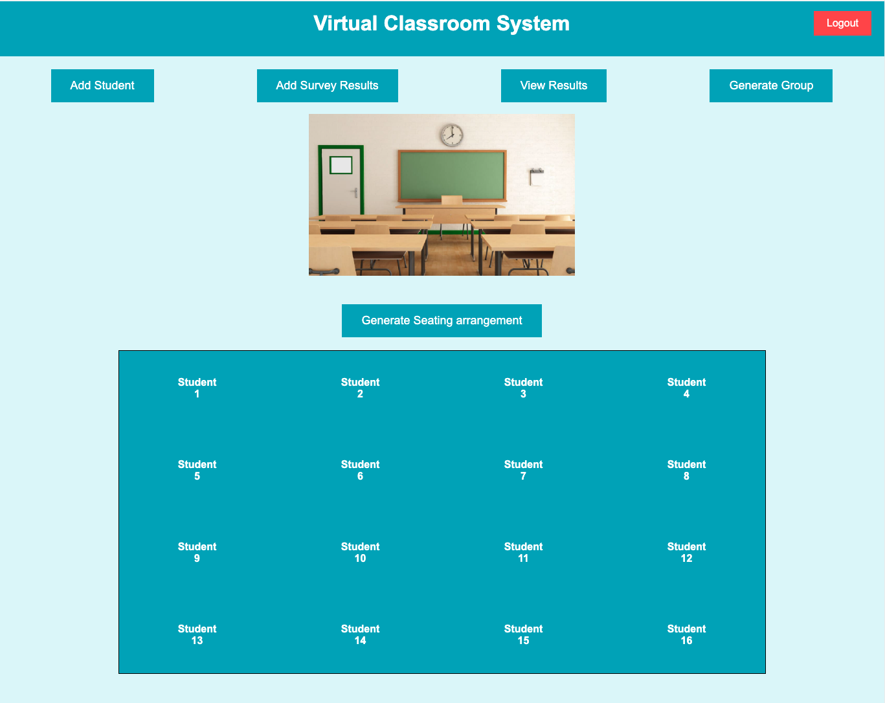
GUI

Slide 22

Yoda Amer
Nabi Mari

